Slide 1
“The Sermon On The Amount”
Sunday 7th June 2026
Thurrock Christian Fellowship Financial Report: Year 2025-26
By Andy Acreman, on behalf of the TCF Charity Directors
Notes:
Our Charity Directors (Ricky, Steve, Oyin, Me) have a duty to keep the church up to speed with its financial position.
It gives those who donate money information on what their donations are being used for.
None of the Charity Directors receive any remuneration at all – they cannot, since it is illegal. The only thing they can claim for is legitimate ‘out of pocket’ expenses accompanied by a receipt.
I want to think all Charity Directors for the hard work they put in throughout the year and the responsibility they take.

Slide 2
Items Covered Briefly
Total Income & Expenditure – unhelpful!
Church & General Finances
Spacious Place Café Finances
Mission and Compassion Funds
What we all need to be ‘In Faith’ for?
“An Encouragement to Give” (from Oyin)
Thank You – from the Leaders & Charity Directors
Notes:
I will cover the six of these headings and Oyin will cover the sixth one
Quick glance at what the accountants call ‘Consolidated’ or ‘Aggregated’ totals – All the income and expenditure coming in and out of the Charity. Ignores internal transfers but the most meaningful numbers are swamped by Foodbank and Preschool finances.
Focus today on the Church, on Spacious Place Café, and on the Mission and Compassion Funds.
God requires us to take some serious steps of faith in this new financial year.
Oyin will deliver ‘An Encouragement to Give’.

Slide 3
Charity Aggregate Income / Expenditure
Notes:
These are in the Incomes and Expenditures for the last two financial years. It looks like HUGE amounts of money both IN and OUT.
These totals include all of: Thurrock Christian Fellowship church, General account, Foodbank, Preschool, Café, Mission and Compassion Funds. Overall, we are a big enterprise, and a lot of money passes through our bank accounts.
We are a single charity but most of the money that comes in is ‘Restricted’, which means that it cannot be used for just any purpose within TCF. If someone gives to Foodbank to buy food, then we cannot spend it on anything else, like redecorating this hall, for example!
Some years we make a small surplus and some a small deficit. This is quite usual.
The trouble with aggregated income and expenditure is that it clouds the picture and we need to see more detail. Since I am presenting to the Church today, I intend to focus on those finances that directly affect church activities…

Slide 4
Church & General Income / Expenditure
Notes:
We can see here there Church and General Fund income for the last two financial years, ending in March 2026. Then, on the right is the Budget for this current financial year: April 2026 until March 2027.
Last year, we made a ‘loss’ of about £5.5k, which was covered by our ‘Reserves’ (money in the bank).
This year, we are budgeting for a £10k surplus – which is a step of faith. Move about that later!
If we look more closely at those blue INCOME bars, we can see more detail…

Slide 5
Church / General Income Breakdown
Notes:
As you can see, the majority of our Church / General Fund income comes from three sources:
1. Regular Giving from Church Members, including Gift Aid; 2. A Facilities payment from Foodbank; 3. A Facilities payment from Preschool.
Hall Hire also plays a small part.
We are budgeting for a significant uplift in Church Giving this year – of around £10k more than last year – that is about 34 percent more!
This is a clear step of faith by the Leaders and Charity Directors; we are trusting God for more people each giving more money. We ask that you stand with us in this step of faith.

Slide 6
Church / General Expenditure Breakdown
Notes:
Our expenditure goes predominantly on employment costs – in other words, we invest in people! Which is as it should be.
However, we could not operate as a church without so many people giving of their time and energies free of charge – as volunteers.
We make sure that as much as possible goes on Mission and Ministry too.

Slide 7
Spacious Place Café – Income / Expend.
Notes:
Last year, the Café make a significant loss of about £30k. We are not greatly concerned about this, since it is an outreach ministry.
However, in this current year, the budget is for us to make a £12.5k surplus. So that is also a bit of a step of faith! We have increased our prices – as most of you already know, because you support it – and the aim is not to make huge profits but to at least cover our costs.
A breakdown of the Café’s income is as follows…

Slide 8
Spacious Place Café Income Breakdown
Notes:
As you can see, we received a lot of donation and grant money in the first couple of years of the Café’s life, but this is now diminishing.
We are now having to cover our costs by selling our food and drink at more realistic levels – which is one of the reasons we have increased our menu prices. Most customers accept that this is a fact of life across the entire hospitality sector.
Please support our Café by blessing us with your presence and your purse!

Slide 9
Spacious Place Café Expend. Breakdown
Notes:
We can see that by far the biggest category of expenditure is the cost of employing our paid staff. The government has increased this in several ways:
1. Increase in the National Minimum Wage by above the rate of inflation, and by 8.5 percent for 18-20 year olds.
2. The Employers’ National Insurance has increased from 13.8 to 15.0 percent of salary.
3. The Employers’ National Insurance starts at £5,000 per year, rather than £9,100 per year, so more lower paid and part-time employees pay it.
This is partly offset by an Employment Allowance for charities, where we get a small refund.

Slide 10
TCF Mission Fund Annual Budget 2026-27
Notes:
We give ten percent (a tithe) of our Church income away to other organisations and people who are doing ‘mission’. This is to bless others, rather than TCF.
The Charity Directors approve the annual total amount, and the TCF Leaders decide where to allocate it.
Here is the 2026-27 Budget for our Mission Fund: Notice that there is quite a bit of money carried over from previous years
If you have further ideas of Christian ministries to which we could donate this, please speak to a TCF Leader about it.

Slide 11
TCF Compassion Fund 2025-26
Notes:
Our Compassion Fund is used to provide financial assistance to people we encounter who have short-term financial needs.
We top up this fund with 3.33 percent of our Church income. As you can see (above), these anonymised payments were made in the previous financial year.
We have a healthy balance in the fund at present and we do not plan to let it build up. Payments are used to help Foodbank clients or people we encounter in the Café, or Church members, or even some of our employed staff or volunteers – anyone we think is in genuine need who we can meaningfully help.
It has been agreed that TCF Leaders, Charity Directors, and David A. can all approve up to £75 per payment when they come across a need. Higher amounts would involve more consultation. But if you know of anyone with genuine needs connected to TCF in some way, then please speak up to one of us.

Slide 12
“A Step of Faith for TCF…”
We plan to raise £40,000 in Tithes + Offerings this year.
Up by £10,000 from the previous year.
Notes:
More people each giving more generously…

Slide 13
“An Encouragement to Give…”
By Oyin Ayandokun
- A Charity Director of Thurrock Christian Fellowship

Slide 14
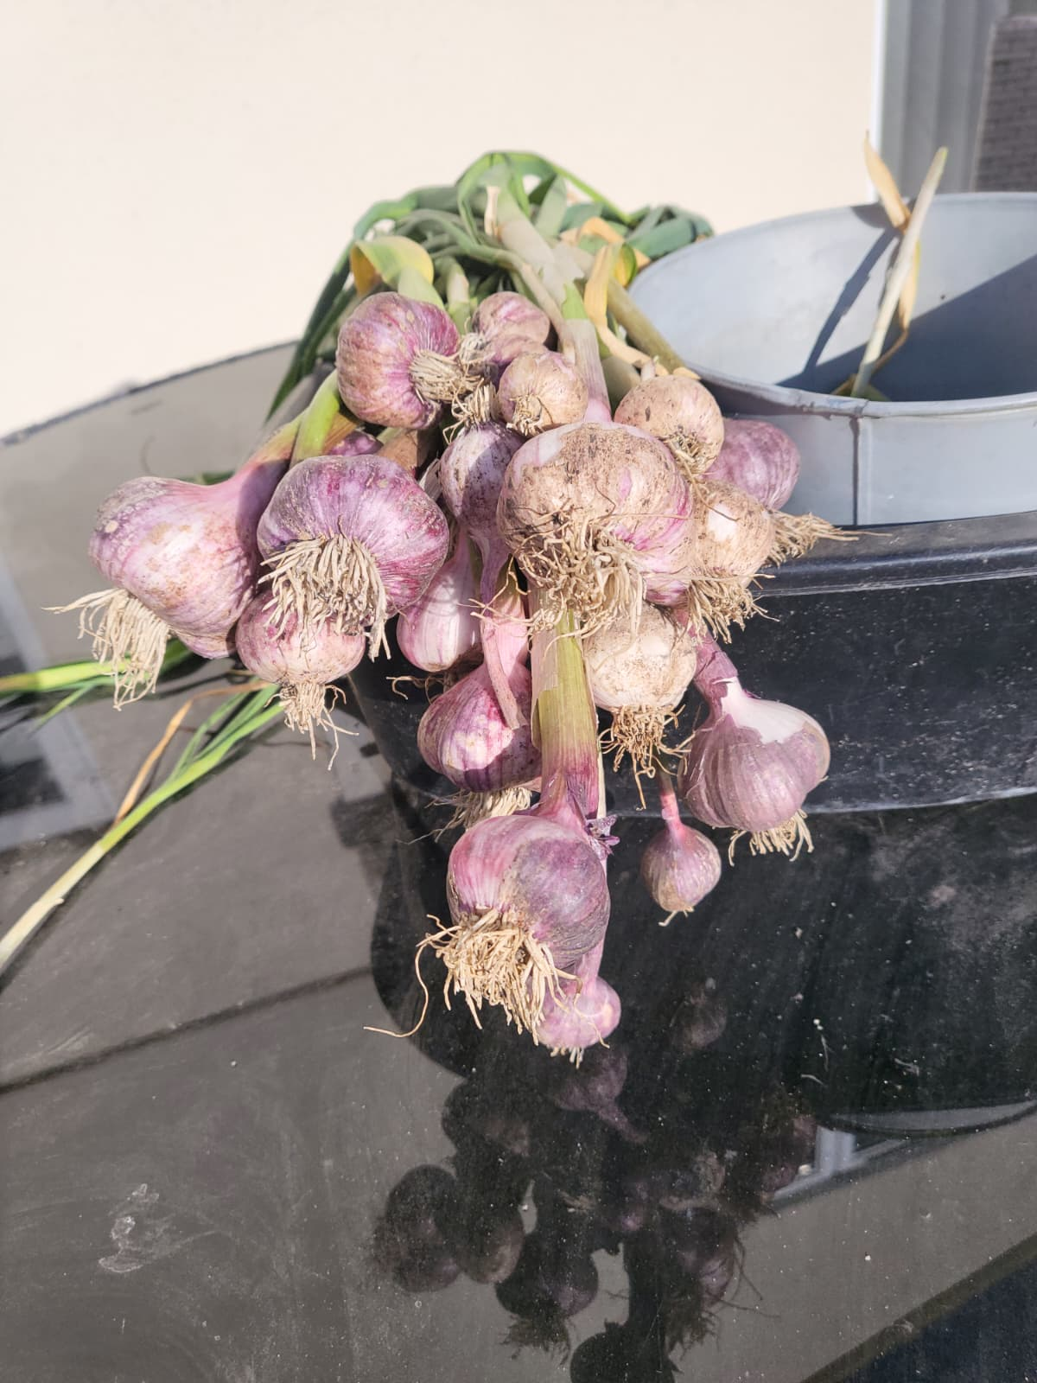

Slide 15
2 Corinthians 9:6-8 AMP
[6] Now [remember] this: he who sows sparingly will also reap sparingly, and he who sows generously [that blessings may come to others] will also reap generously [and be blessed]. [7] Let each one give [thoughtfully and with purpose] just as he has decided in his heart, not grudgingly (or reluctantly) or under compulsion, for God loves a cheerful giver [and delights in the one whose heart is in his gift]. [Prov 22:9] [8] And God is able to make all grace [every favour and earthly blessing] come in abundance to you, so that you may always [under all circumstances, regardless of the need] have complete sufficiency in everything [being completely self-sufficient in Him], and have an abundance for every good work and act of charity.

Slide 16
A Big Thank You…
…from the Leaders and Charity Directors of Thurrock Christian Fellowship.
We couldn’t have done any of this without your prayers, presence, and generosity. Keep it up!
Q & A

